Slide 1


The Power of Mobile Price Prediction
In today's rapidly evolving technological landscape, the ability to accurately predict mobile phone prices has become increasingly crucial. Machine learning algorithms have emerged as powerful tools, enabling automated decision-making, predictive analytics, and intelligent automation across various domains. This comprehensive study delves into the intricacies of classification algorithms, exploring their underlying principles, efficacy, and applicability in the realm of mobile price forecasting. By harnessing the insights gleaned from this research, practitioners, researchers, and enthusiasts can navigate the complex landscape of mobile technology with confidence and clarity.

Slide 2
Exploring Traditional Techniques
Decision Trees
Logistic Regression
K-Nearest Neighbors
Decision trees are a popular supervised learning technique that employ a tree-like structure to make predictions. They excel at capturing complex relationships within the data and are particularly adept at handling both numerical and categorical features.
Logistic regression is a statistical model used for binary classification tasks. It determines the probability of an event occurring based on one or more predictor variables, making it a powerful tool for mobile price prediction.
K-Nearest Neighbors (KNN) is a non-parametric algorithm that classifies data points based on their proximity to their nearest neighbors. Its simplicity and intuitive nature make it a versatile choice for mobile price prediction.

Slide 3
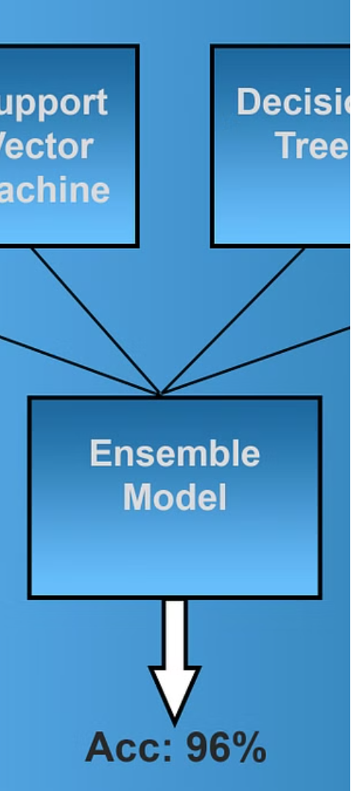
Ensemble Methods: Boosting the Performance
1
Random Forest
Random Forest is an ensemble learning method that combines multiple decision trees to improve predictive accuracy and reduce overfitting. Its ability to handle a wide range of data types and its robustness to noise make it a compelling choice for mobile price prediction.
2
Gradient Boosting
Gradient Boosting is a powerful ensemble technique that sequentially builds weak learners, often decision trees, to create a strong predictive model. Its adaptability and high performance make it a popular choice for mobile price forecasting.
3
XGBoost
XGBoost, or Extreme Gradient Boosting, is a highly efficient and scalable implementation of gradient boosting. Its advanced optimization techniques and parallelization capabilities make it a top-performing algorithm for mobile price prediction.

Slide 4
Advanced Techniques: Pushing the Boundaries
1
Support Vector Machines (SVM)
2
Neural Networks
3
Gaussian Processes
Neural networks, inspired by the human brain, are capable of learning complex patterns in data. Their versatility and adaptability make them well-suited for mobile price forecasting, particularly in capturing non-linear relationships.
SVM is a powerful supervised learning algorithm that finds the optimal hyperplane to separate different classes. Its ability to handle high-dimensional data and its robustness to overfitting make it a strong contender for mobile price prediction.
Gaussian Processes are a probabilistic approach to machine learning, providing not only predictions but also uncertainty estimates. This can be valuable in mobile price prediction, where understanding the confidence in forecasts is crucial.

Slide 5
Evaluating Model Performance
Accuracy
Precision and Recall
Accuracy is a fundamental metric for evaluating the performance of classification algorithms. It measures the proportion of correct predictions made by the model, providing a high-level assessment of its overall effectiveness.
Precision and recall are complementary metrics that provide insights into the model's ability to correctly identify positive instances and minimize false positives and false negatives.
F1-Score
ROC-AUC
The F1-score is a harmonic mean of precision and recall, offering a balanced measure of a model's performance that considers both type I and type II errors.
The area under the receiver operating characteristic (ROC) curve, or ROC-AUC, evaluates a model's ability to distinguish between different classes, providing a comprehensive assessment of its discriminative power.

Slide 6




Interpreting and Explaining Models
Interpretability
Scalability
Robustness
Generalization
The ability to understand and explain the decision-making process of a model is crucial, particularly in domains where transparency and accountability are paramount.
As the volume and complexity of mobile phone data continue to grow, the scalability of classification algorithms becomes increasingly important, ensuring efficient and reliable performance on large-scale datasets.
The ability of a model to maintain its performance in the face of noisy, incomplete, or adversarial data is a key consideration, particularly in real-world mobile price prediction scenarios.
The capacity of a model to perform well on unseen data, beyond the training set, is essential for ensuring the reliability and practical applicability of mobile price prediction systems.

Slide 7
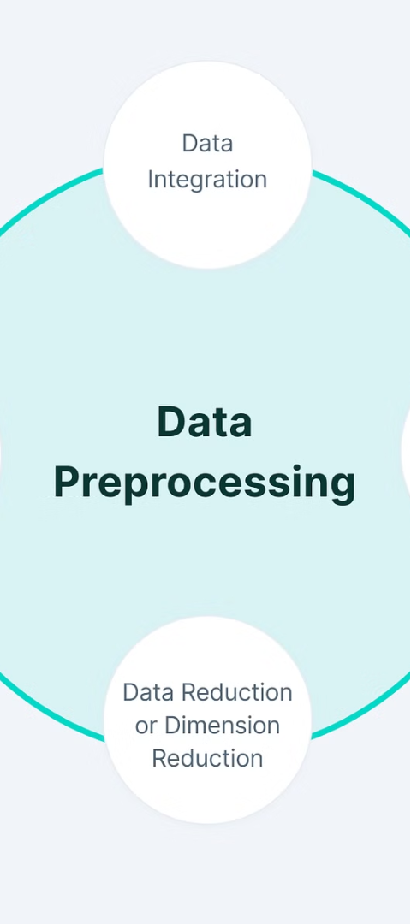



Bridging Theory and Practice
Data Preprocessing
Careful data preprocessing, including handling missing values, outlier detection, and feature engineering, is a crucial step in ensuring the quality and reliability of the input data for mobile price prediction models.
Model Selection
Selecting the appropriate classification algorithm for a given mobile price prediction task requires a deep understanding of the strengths, weaknesses, and trade-offs of various techniques, as well as the characteristics of the dataset at hand.
Hyperparameter Tuning
Optimizing the hyperparameters of classification models, such as the learning rate, regularization, and the number of trees in ensemble methods, can significantly impact their performance and generalization capabilities.

Slide 8
Real-World Applications and Implications
E-commerce Platforms
Leveraging mobile price prediction models to adaptively adjust pricing strategies, considering factors like demand, competition, and inventory levels.
Retail Chains
Utilizing price prediction algorithms to stay competitive in the mobile phone market, monitoring price fluctuations and consumer preferences.
Price Comparison Websites
Integrating price prediction models to provide users with real-time price estimates and help them find the best deals.
Mobile Manufacturers
Employing price prediction models to optimize product pricing and positioning, analyzing factors like features, brand reputation, and consumer sentiment.

Slide 9

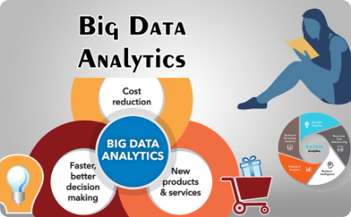

Continuous Improvement and Future Directions
Advancing Algorithms
Leveraging Big Data
Fostering Collaboration
Exploring the potential of emerging techniques, such as deep learning and hybrid models, to further enhance the accuracy and robustness of mobile price prediction systems.
Incorporating a broader range of data sources, including user sentiment, economic indicators, and market trends, to gain a more comprehensive understanding of the factors influencing mobile phone prices.
Encouraging interdisciplinary collaboration between data scientists, industry experts, and mobile phone manufacturers to develop tailored solutions that address specific market needs and consumer preferences.

Slide 10




Conclusion: Unlocking the Future of Mobile Technology
Predictive Modeling Advancements
The continued evolution and refinement of predictive modeling techniques for mobile price forecasting will be crucial in shaping the future of the mobile technology industry, driving innovation and enhancing consumer experiences.
Informed Decision-Making
By leveraging the insights and capabilities of mobile price prediction models, industry stakeholders can make more informed decisions, optimize pricing strategies, and better cater to the evolving needs and preferences of mobile consumers.
Unlocking New Possibilities
As the field of mobile price prediction continues to advance, it will unlock new possibilities for the mobile technology industry, fostering greater efficiency, competitiveness, and ultimately, enhancing the overall user experience.

